Slide 1

Unit I
Modular Arithmetic : Multiplicative inverse, extended euclidean algo
Refer : Chapter 2 , Fourozan
2.<number>
Copyright © The McGraw-Hill Companies, Inc. Permission required for reproduction or display.

Slide 2
Chapter 2
Objectives
To review integer arithmetic, concentrating on divisibility
and finding the greatest common divisor using the Euclidean
algorithm
To understand how the extended Euclidean algorithm can be
used to solve linear Diophantine equations, to solve linear
congruent equations, and to find the multiplicative inverses
To emphasize the importance of modular arithmetic and
the modulo operator, because they are extensively used in
cryptography
To emphasize and review matrices and operations on residue
matrices that are extensively used in cryptography
To solve a set of congruent equations using residue matrices
2.<number>

Slide 3
2.1.3 Integer Division
In integer arithmetic, if we divide a by n, we can get q
And r . The relationship between these four integers can be shown as
a = q × n + r
2.<number>

Slide 4
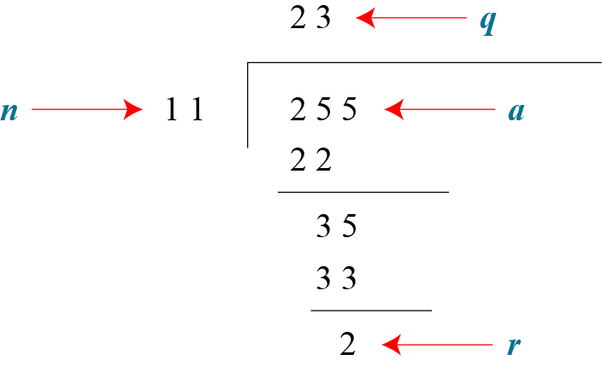
2.1.3 Continued
Example 2.2
Assume that a = 255 and n = 11. We can find q = 23 and R = 2 using the division algorithm.
Figure 2.3 Example 2.2, finding the quotient and the remainder
2.<number>

Slide 5
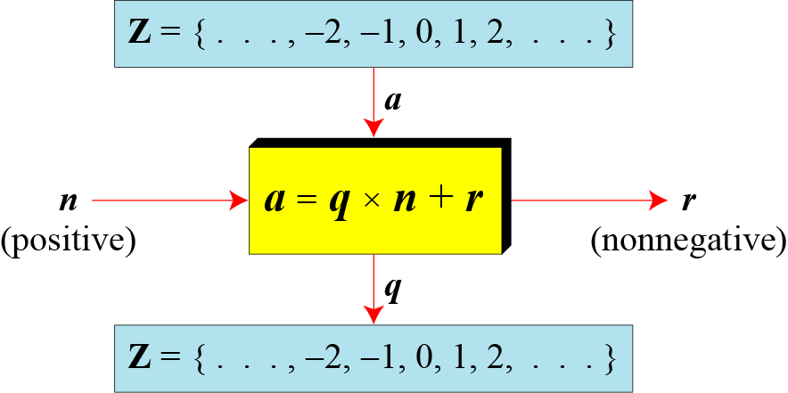
2.1.3 Continued
Figure 2.4 Division algorithm for integers
2.<number>

Slide 6
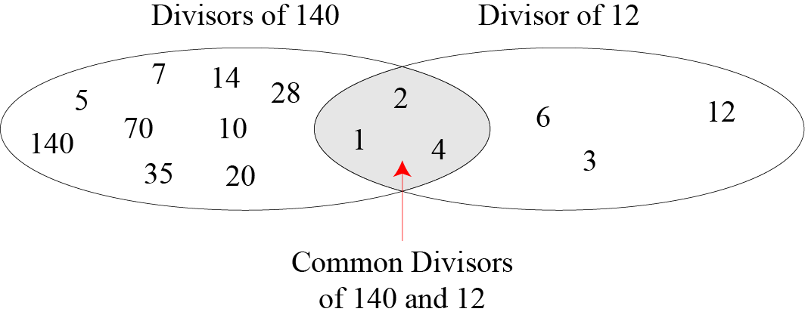
2.1.4 Continued
Figure 2.6 Common divisors of two integers
2.<number>

Slide 7

2.1.4 Continued
Note
Greatest Common Divisor
The greatest common divisor of two positive integers is the largest integer that can divide both integers.
Note
Euclidean Algorithm
Fact 1: gcd (a, 0) = a
Fact 2: gcd (a, b) = gcd (b, r), where r is
the remainder of dividing a by b
2.<number>

Slide 8
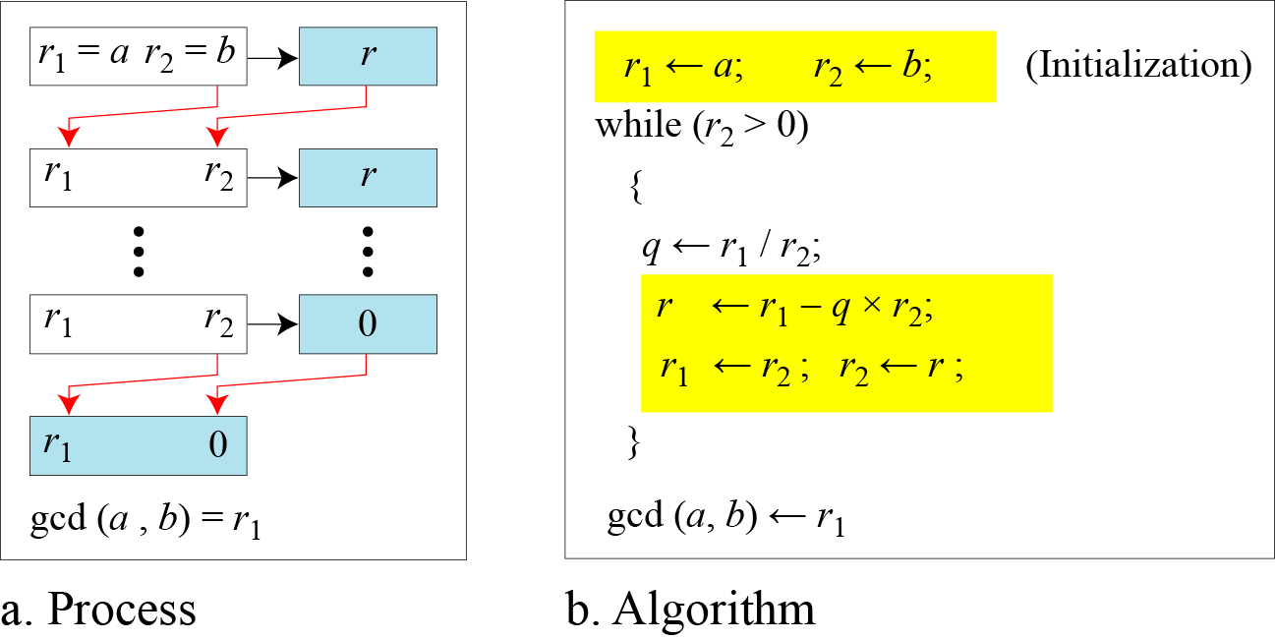
2.1.4 Continued
Figure 2.7 Euclidean Algorithm
Note
When gcd (a, b) = 1, we say that a and b are relatively prime.
2.<number>

Slide 9
2.1.4 Continued
Note
When gcd (a, b) = 1, we say that a and b are relatively prime.
2.<number>

Slide 10
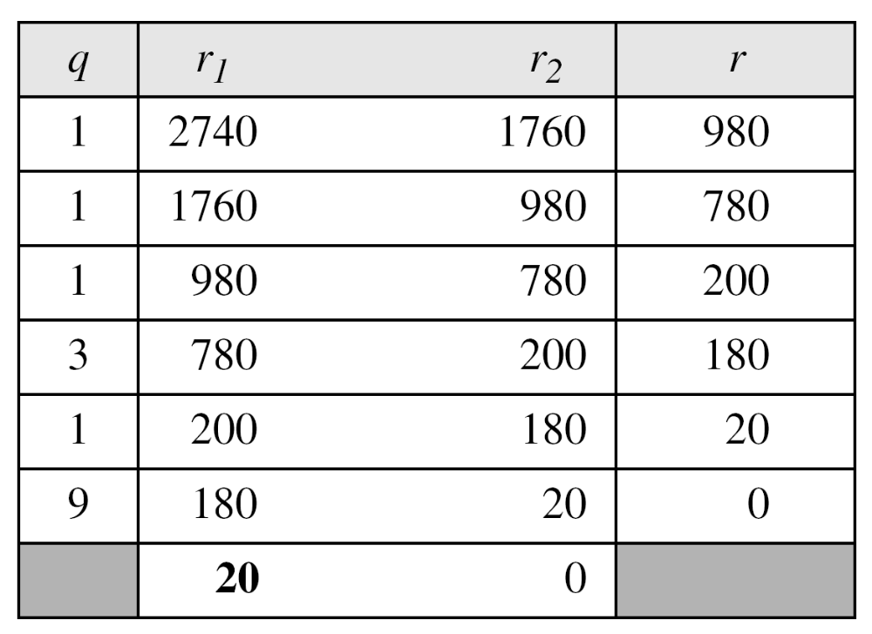
2.1.4 Continued
Example 2.7
Find the greatest common divisor of 2740 and 1760.
Solution
We have gcd (2740, 1760) = 20.
2.<number>

Slide 11
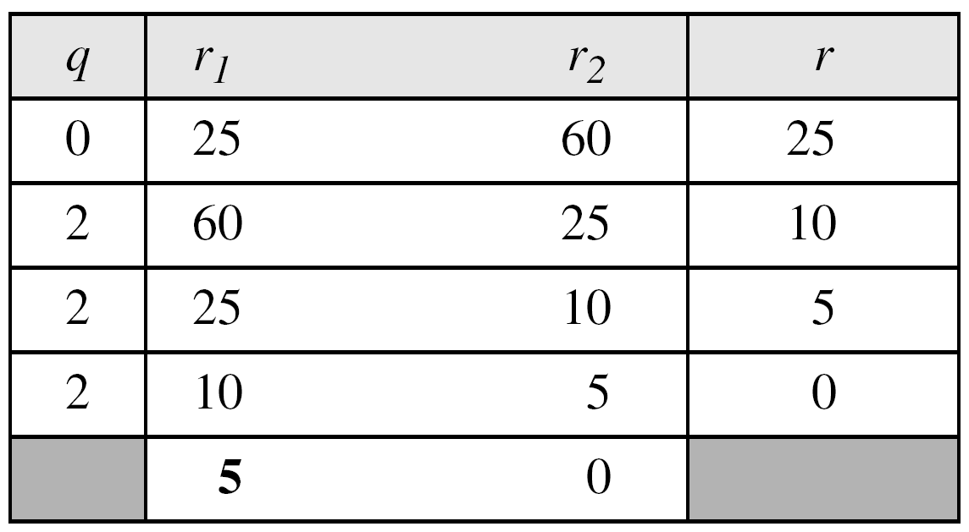
2.1.4 Continued
Example 2.8
Find the greatest common divisor of 25 and 60.
Solution
We have gcd (25, 65) = 5.
2.<number>

Slide 12

2.1.4 Continued
Extended Euclidean Algorithm
Given two integers a and b, we often need to find other two integers, s and t, such that
The extended Euclidean algorithm can calculate the gcd (a, b) and at the same time calculate the value of s and t.
2.<number>

Slide 13
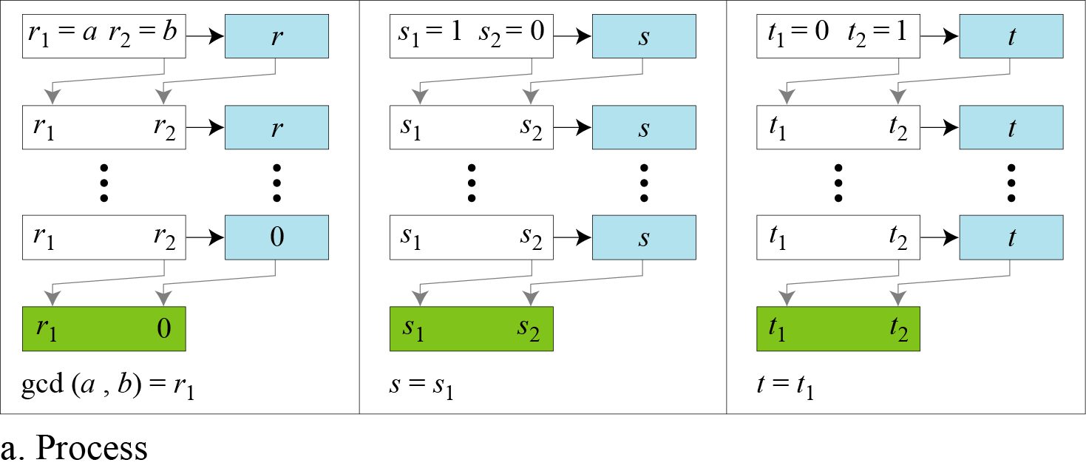
2.1.4 Continued
Figure 2.8.a Extended Euclidean algorithm, part a
2.<number>

Slide 14
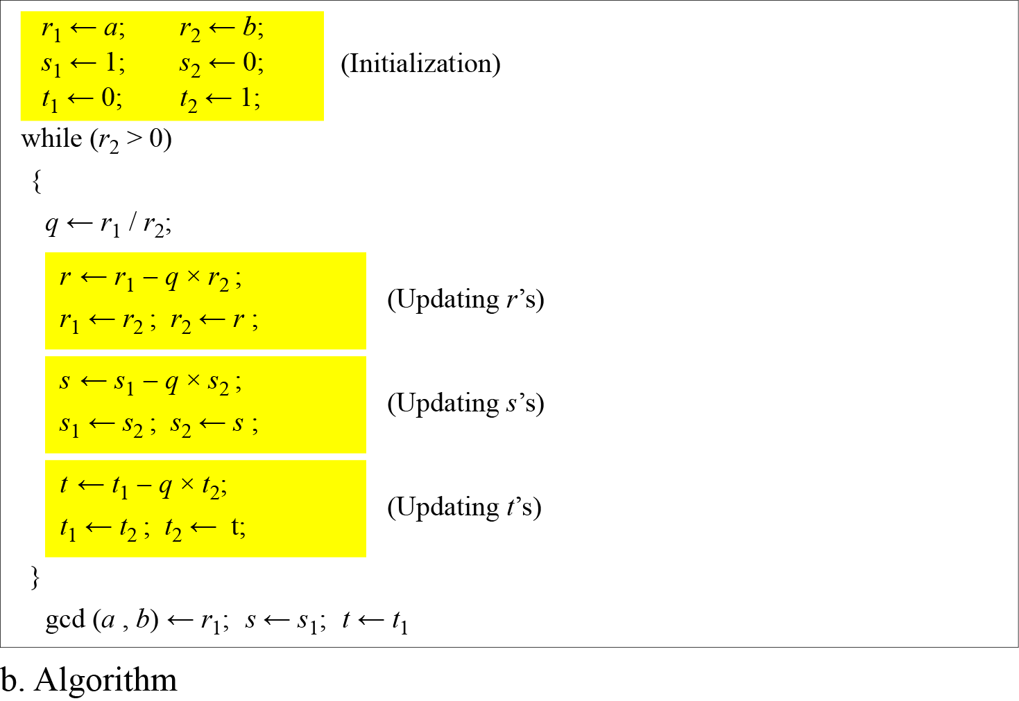
2.1.4 Continued
Figure 2.8.b Extended Euclidean algorithm, part b
2.<number>

Slide 15
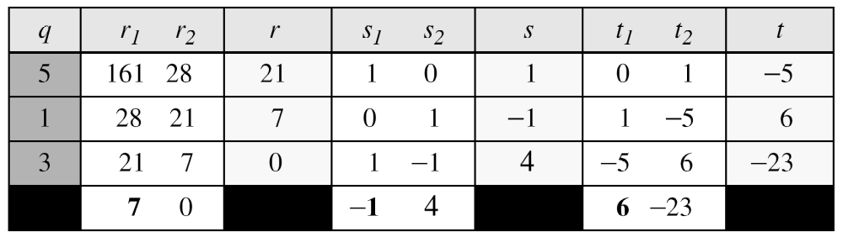
2.1.4 Continued
Example 2.9
Given a = 161 and b = 28, find gcd (a, b) and the values of s and t.
Solution
We get gcd (161, 28) = 7, s = −1 and t = 6.
2.<number>

Slide 16
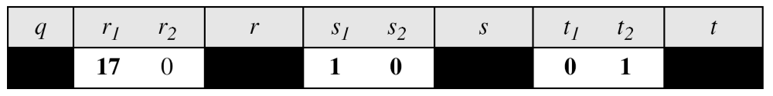
2.1.4 Continued
Example 2.10
Given a = 17 and b = 0, find gcd (a, b) and the values of s
and t.
Solution
We get gcd (17, 0) = 17, s = 1, and t = 0.
2.<number>

Slide 17
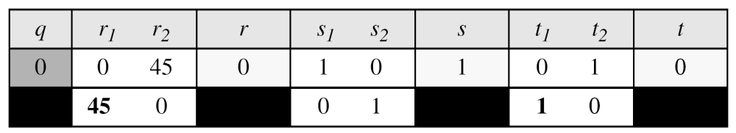
2.1.4 Continued
Example 2.11
Given a = 0 and b = 45, find gcd (a, b) and the values of s
and t.
Solution
We get gcd (0, 45) = 45, s = 0, and t = 1.
2.<number>

Slide 18
2.2.5 Continued
Note
The extended Euclidean algorithm finds the multiplicative inverses of b in Z_{n} when n and b are given and
gcd (n, b) = 1.
The multiplicative inverse of b is the value of t after being mapped to Z_{n}.
2.<number>

Slide 19
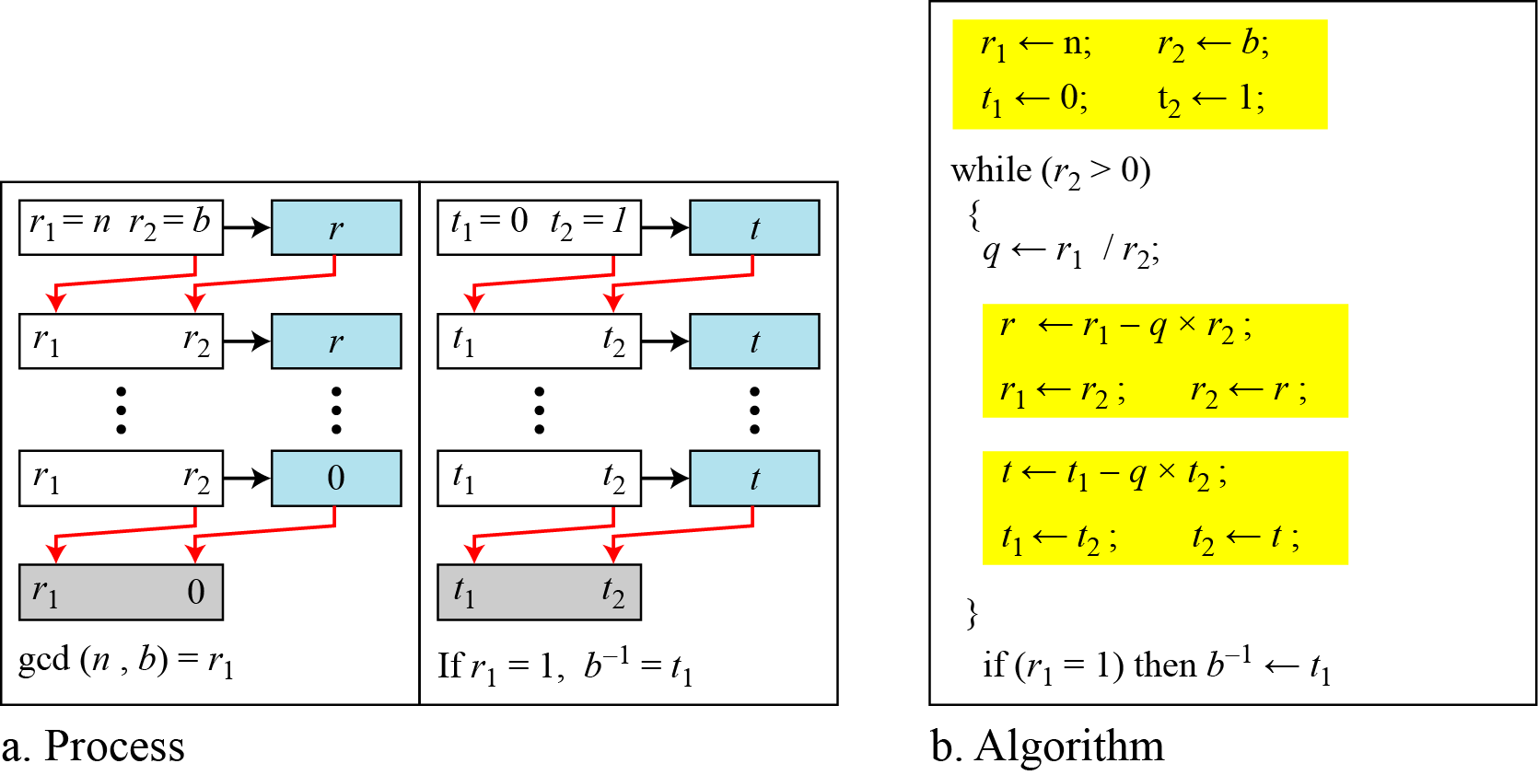
2.2.5 Continued
Figure 2.15 Using extended Euclidean algorithm to
find multiplicative inverse
2.<number>

Slide 20
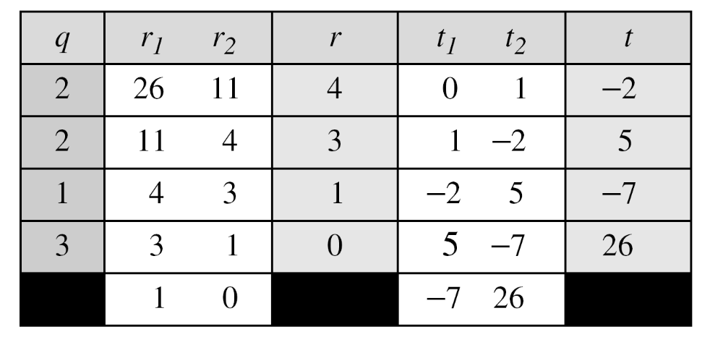
2.2.5 Continued
Example 2.25
Find the multiplicative inverse of 11 in Z₂₆.
Solution
The gcd (26, 11) is 1; the inverse of 11 is −7 or 19.
2.<number>

Slide 21
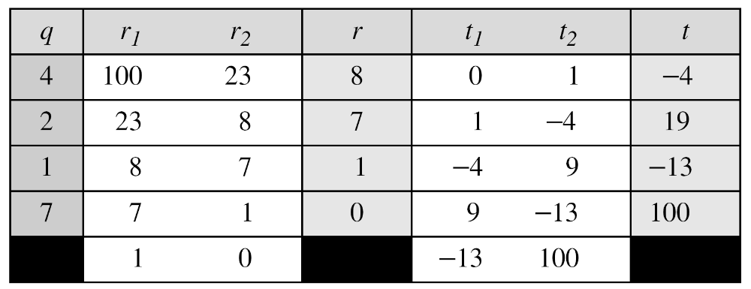
2.2.5 Continued
Example 2.26
Find the multiplicative inverse of 23 in Z₁₀₀.
Solution
The gcd (100, 23) is 1; the inverse of 23 is −13 or 87.
2.<number>

Slide 22
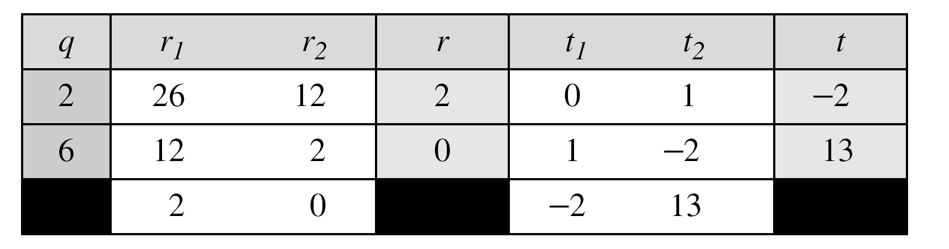
2.2.5 Continued
Example 2.27
Find the inverse of 12 in Z₂₆.
Solution
The gcd (26, 12) is 2; the inverse does not exist.
2.<number>

